Slide 1
Machine Learning
Resume Screening

Slide 2
ML : for Resume Screening
NLP & Machine Learning powered algorithm screens, matches, and ranks resumes to identify best candidates
Challenge #1 : Volume
Challenge #2 : Quality of Profiles
Key Facts
Average 100+ resumes are screened / single candidature
Time spent /resumes = 5 mins to 10 mins
No comparative stats while selection / rejection of the resumes
Response Window
24 hrs. to 48 Hrs.
Solution Resume Screening through ML :
Efficiency & Effective
Instantly determine the correct resumes
Screen every resume
Empowered Recruiters
Future : an interface can help in determining the right skills for the profile
Intelligent Rankings with Rationale
Determine the matching score and ranks

Slide 3
ML : Resume Screening Workflow
72 resumes
Classifier
NLP
Data
Collection
Support Vector Machine
Candidate
Resumes
Train 50
Test 22
Model Training & Performance tuning
Weightage Score
Remove Stopwords
Count Vectorizer
Ranking algorithm
through NLP
Data Cleaning &
Preparation
Accuracy 75-80 %
F1 score
Modal
Evaluation
Word cloud
NLTK Tokenizer
Data
Visualization & Analysis
Prediction : Selected

Slide 4
Workflow
ML : Models Approach
ML Models | Advantage | Gaps | Accuracy | F1 score
SVM | The main reason to use an SVM instead is because the problem might not be linearly separable. In that case, we will have to use an SVM with a non linear kernel (e.g. RBF). Another related reason to use SVMs is if you are in a highly dimensional space. For example, SVMs have been reported to work better for text classification. | It requires a lot of time for training. So, it is not recommended when we have a large number of training examples | 72 | 78
NaiveBayes | It is a probabilistic classifier, which means it predicts on the basis of the probability of an object. Naïve Bayes is one of the fast and easy ML algorithms to predict a class of datasets. | Naive Bayes assumes that all features are independent or unrelated, so it cannot learn the relationship between features. | 61 | 68
Random Forest | They can handle categorical features very well. This algorithm can handle high dimensional spaces as well as large number of training examples | It requires much computational power as well as resources as it builds numerous trees to combine their outputs. It also requires much time for training as it combines a lot of decision trees to determine the class. | 66 | 70

Slide 5
Appendix

Slide 6
Workflow
Appendix : Resume Weightage
Statistics | Weightage | Machine learning | Weightage | Deep Learning | Weightage | Python language | Weightage | NLP | Weightage | Data Engineering | Weightage
statisticalmodels | 10 | linear regression | 10 | neural network | 10 | Python language | 10 | nlp | 10 | aws | 10
statisticalmodeling | 10 | logistic regression | 10 | keras | 10 | python | 2 | natural language processing | 10 | ec2 | 10
probability | 10 | K means | 10 | theano | 10 | flask | 2 | topic modeling | 10 | amazon redshift | 10
normal distribution | 10 | random forest | 10 | face detection | 10 | django | 5 | Ida | 10 | s3 | 10
poisson distribution | 10 | xgboost | 10 | neural networks | 10 | pandas | 5 | named entity recognition | 10 | docker | 10
survival models | 10 | svm | 10 | convolutional neuralnetwork (cnn) | 10 | numpy | 3 | pos tagging | 5 | kubemetes | 10
hypothesis testing | 5 | naive bayes | 5 | recurrent neural network(RNN) | 5 | scikitlearn | 3 | word2vec | 5 | scala | 5
bayesian inference | 10 | pca | 10 | object detection | 10 | sklearn | 3 | word embedding | 5 | teradata | 5
factor analysis | 5 | decision trees | 5 | yolo | 5 | matplotlib | 1 | lsi | 5 | google big query | 5
forecasting | 10 | svd | 10 | gpu | 5 | scipy | 1 | spacy | 5 | aws lambda | 5
markov chain | 5 | ensemble models | 5 | cuda | 5 | bokeh | 2 | gensIm | 5 | aws emr | 5
monte carlo | 5 | boltzman machine | 5 | tensorflow | 5 | statsmodel | 10 | nltk | 5 | hive | 5
 |  |  |  | lstm | 2 | AWS | 5 | nmf | 2 | hadoop | 5
 |  |  |  | gan | 2 | ec2 | 7 | doc2vec | 2 | sql | 5
 |  |  |  | opencv | 1 | amazon redshift | 7 | cbow | 1
 |  |  |  |  |  | s3 | 5 | bag of words | 3
 |  |  |  |  |  | docker | 2 | skipgram | 2
 |  |  |  |  |  | kubemetes | 2 | bert | 2
 |  |  |  |  |  | scala | 2 | sentiment analysis | 2
 |  |  |  |  |  | teradata | 2 | chat bot | 1
 |  |  |  |  |  | google big query | 7
 |  |  |  |  |  | aws lambda | 5
 |  |  |  |  |  | aws emr | 2
 |  |  |  |  |  | hive | 2
 |  |  |  |  |  | sql | 5

Slide 7
ML : Stopwords
List for words decided to be removed
'i', 'me', 'my', 'myself', 'we', 'our', 'ours', 'ourselves', 'you', "you're", "you've", "you'll", "you'd", 'your', 'yours', 'yourself', 'yourselves', 'he', 'him', 'his', 'himself', 'she', "she's", 'her', 'hers', 'herself', 'it', "it's", 'its', 'itself', 'they', 'them', 'their', 'theirs', 'themselves', 'what', 'which', 'who', 'whom', 'this', 'that', "that'll", 'these', 'those', 'am', 'is', 'are', 'was', 'were', 'be', 'been', 'being', 'have', 'has', 'had', 'having', 'do', 'does', 'did', 'doing', 'a', 'an', 'the', 'and', 'but', 'if', 'or', 'because', 'as', 'until', 'while', 'of', 'at', 'by', 'for', 'with', 'about', 'against', 'between', 'into', 'through', 'during', 'before', 'after', 'above', 'below', 'to', 'from', 'up', 'down', 'in', 'out', 'on', 'off', 'over', 'under', 'again', 'further', 'then', 'once', 'here', 'there', 'when', 'where', 'why', 'how', 'all', 'any', 'both', 'each', 'few', 'more', 'most', 'other', 'some', 'such', 'no', 'nor', 'not', 'only', 'own', 'same', 'so', 'than', 'too', 'very', 's', 't', 'can', 'will', 'just', 'don', "don't", 'should', "should've", 'now', 'd', 'll', 'm', 'o', 're', 've', 'y', 'ain', 'aren', "aren't", 'couldn', "couldn't", 'didn', "didn't", 'doesn', "doesn't", 'hadn', "hadn't", 'hasn', "hasn't", 'haven', "haven't", 'isn', "isn't", 'ma', 'mightn', "mightn't", 'mustn', "mustn't", 'needn', "needn't", 'shan', "shan't", 'shouldn', "shouldn't", 'wasn', "wasn't", 'weren', "weren't", 'won', "won't", 'wouldn', "wouldn't"

Slide 8
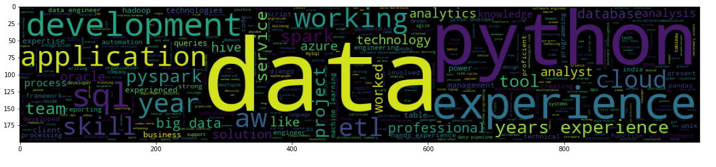
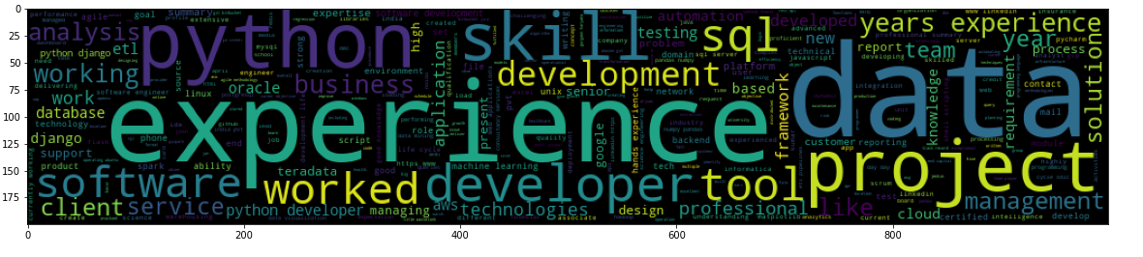
Workflow
ML : WordCloud for Resumes
SELECTED Resumes
REJECTED Resumes

